Slide 1




Evaluating Causal Bayesian Networks for Diabetes Risk Assessment
Ehsan Ramezani Prof. P. Torroni

Slide 2
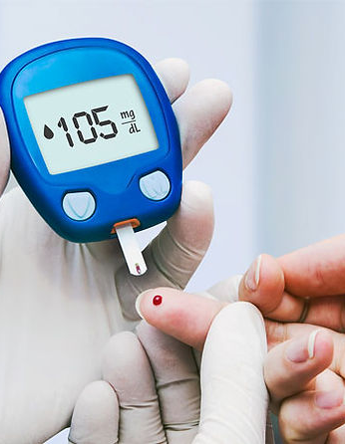
What is diabetes?
Diabetes is a chronic condition that affects how your body regulates blood sugar. With diabetes, your blood sugar levels become too high. This is because your body either doesn't produce enough insulin or doesn't use insulin effectively.
It is a leading cause of blindness, kidney failure, heart disease, and stroke. In 2021, an estimated 463 million people worldwide have diabetes [World Health Organization]. The number of people with diabetes is expected to continue to rise in the coming years.

Slide 3
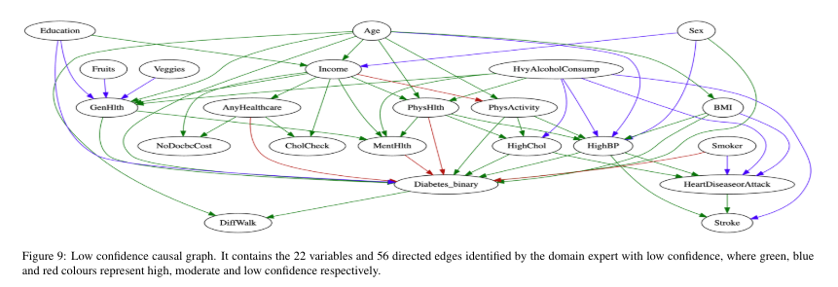
Since I was looking for recent papers on Bayesian networks, I came across this paper about structure learning algorithms in diabetes assessment, which was submitted in March 2024 and was available in archive format on the arXiv platform. [link to the paper]

Slide 4
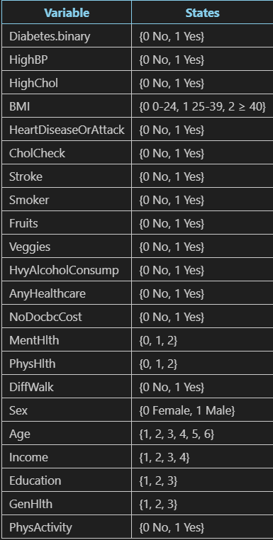
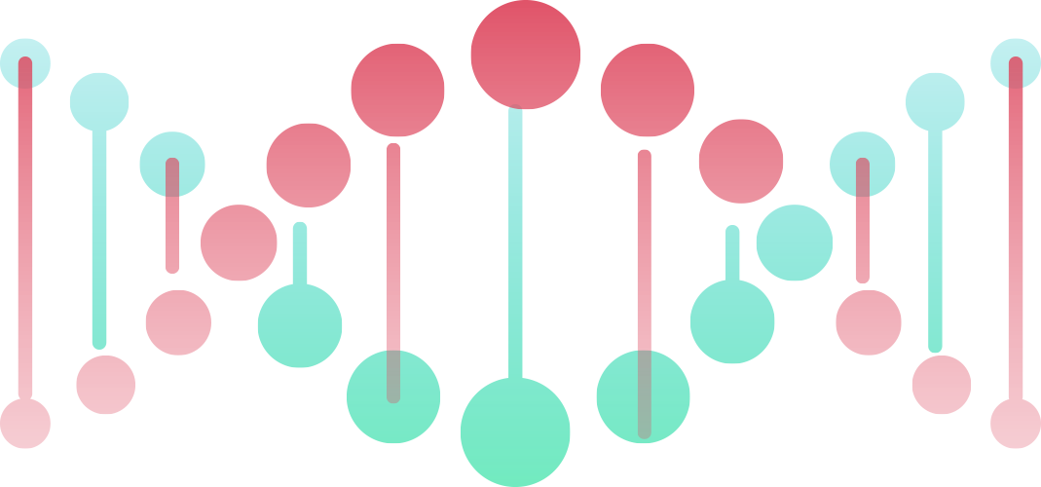
Network Definition
The dataset used in the paper is derived from the Behavioral Risk Factor surveillance system (BRFSS), which is a comprehensive telephone health survey system that collect data from united states residents regarding their health-related risk behaviors. The dataset includes 253,680 health assessments. The dataset covers a broad range of variables, here is the table of our variable:

Slide 5
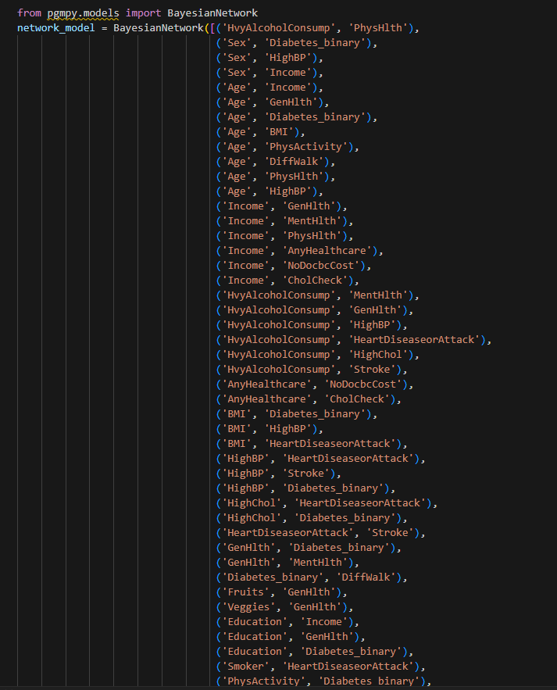
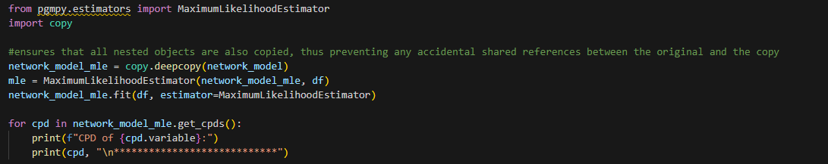
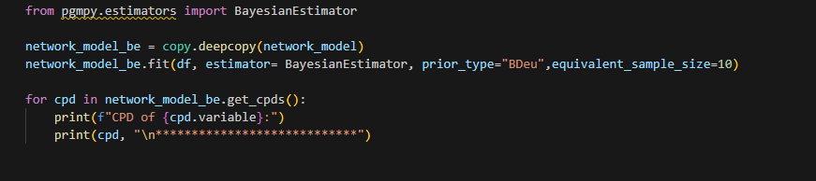
1-Network construction
2- Learning of Network Parameters

Slide 6
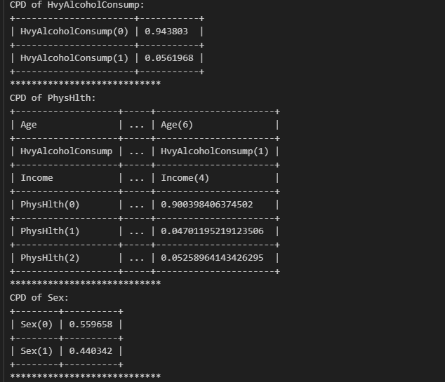
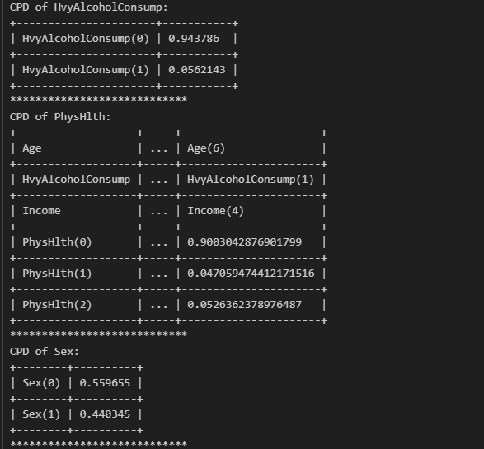
Some of CPTs:
Maximum Likelihood Estimator
Bayesian Estimator
given the large dataset of quarter-million actual observations and minimal differences, it suggests that the data and pre-defined network model by domain experts are strong and consistent enough to robustly estimate the model’s parameters with these two methods.

Slide 7
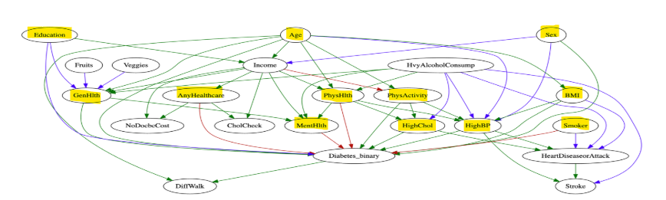
Markov Condition:
(Diabetes_binary ⟂ Stroke, HvyAlcoholConsump, Income, Veggies, Fruits, NoDocbcCost, HeartDiseaseorAttack, CholCheck
| Education, PhysActivity, BMI, PhysHlth, Age, GenHlth, MentHlth, HighBP, Sex, HighChol, AnyHealthcare, Smoker)

Slide 8
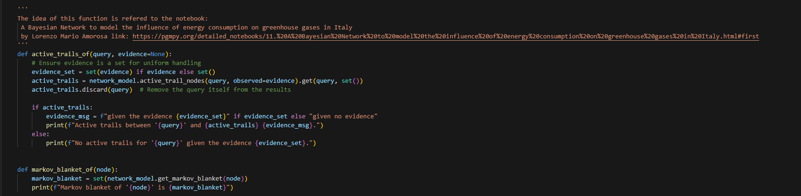
Active Trails:
Active trails between 'HighChol' and {'Stroke', 'Diabetes_binary', 'DiffWalk', 'HeartDiseaseorAttack'} given the evidence {'PhysActivity', 'HvyAlcoholConsump', 'PhysHlth’}.
Markov blanket of 'HeartDiseaseorAttack' is {'Stroke', 'HvyAlcoholConsump', 'BMI', 'HighBP', 'HighChol', 'Smoker'}

Slide 9
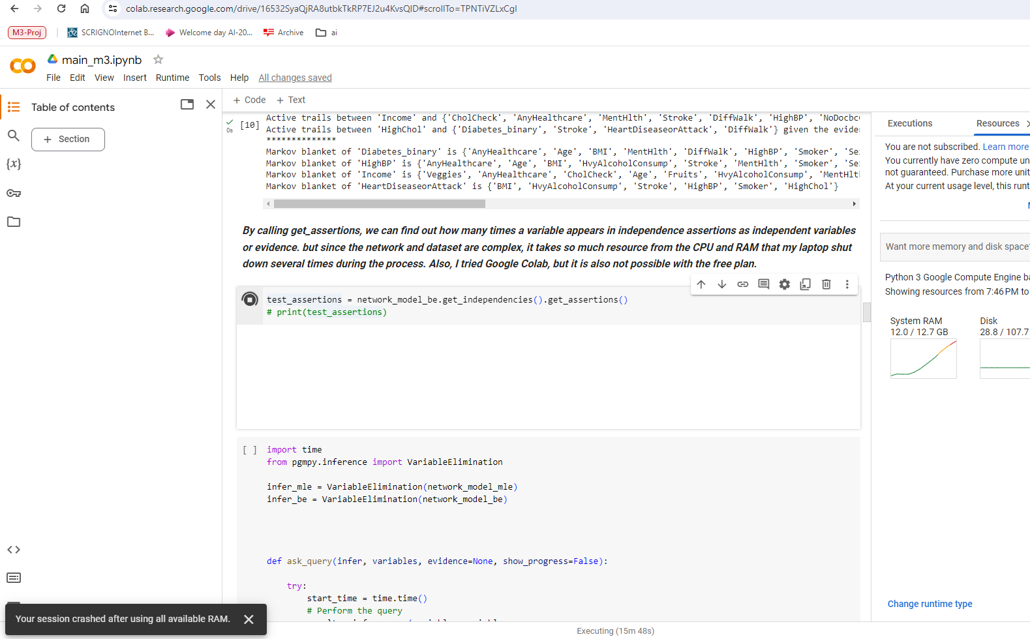
Limitation:

Slide 10
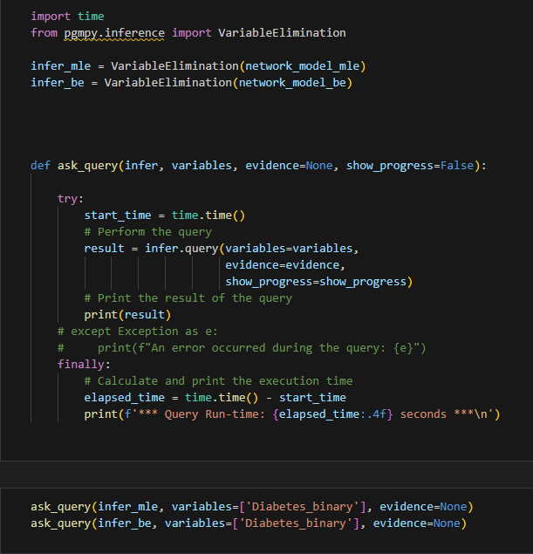
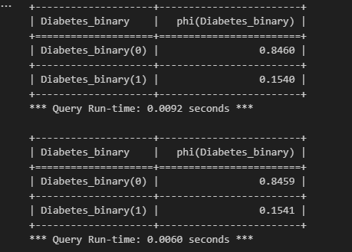
Variable Elimination:

Slide 11
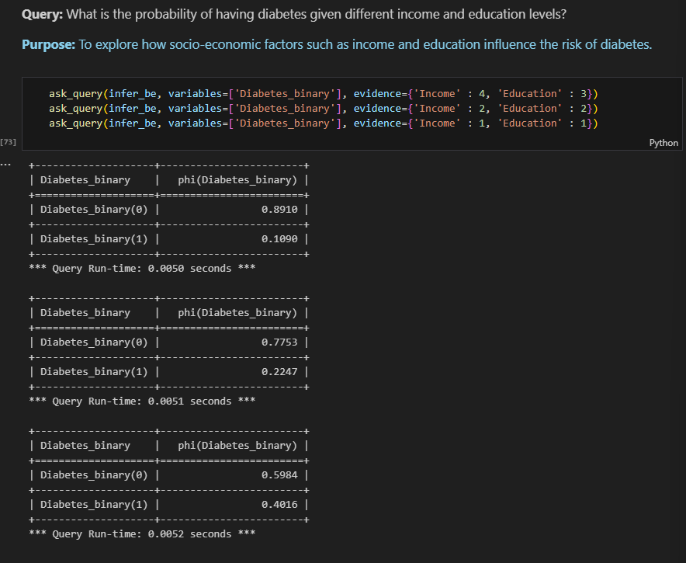
Lower income can reduce access to healthy foods and increase reliance on processed foods, which are frequently high in sugar. In addition, low-income people in America may have limited access to health-care services and be uninformed about general health.

Slide 12
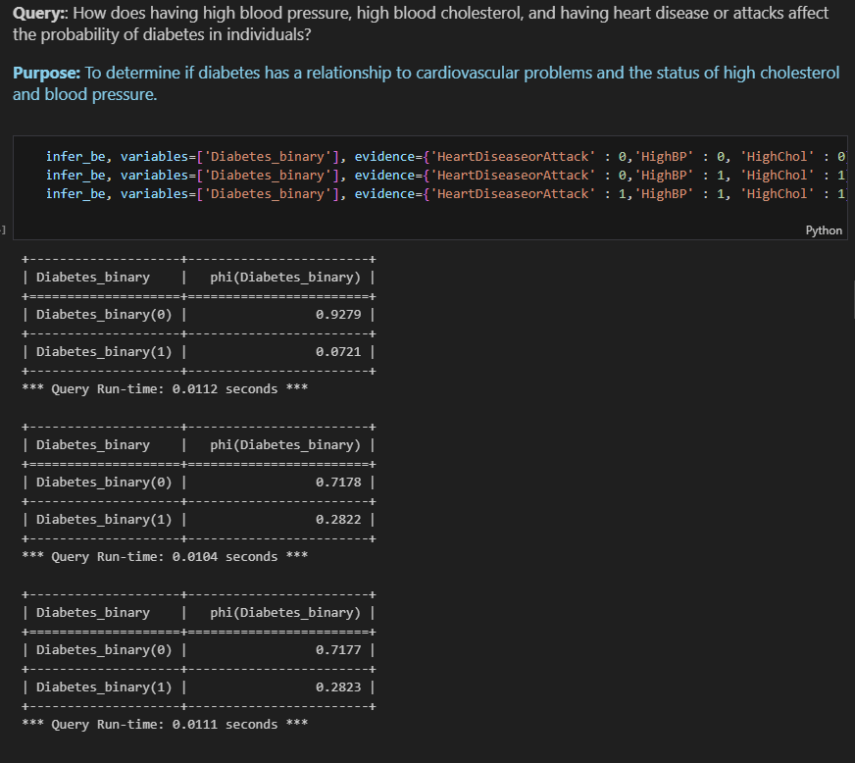
>People with diabetes are more likely to get a stroke or have heart disease. This is a well-known fact according to World Health Organization. On the reverse one, if having heart disease or an attack has nothing to do with diabetes according to results.
>High blood pressure and cholesterol increase the risk of developing diabetes.

Slide 13
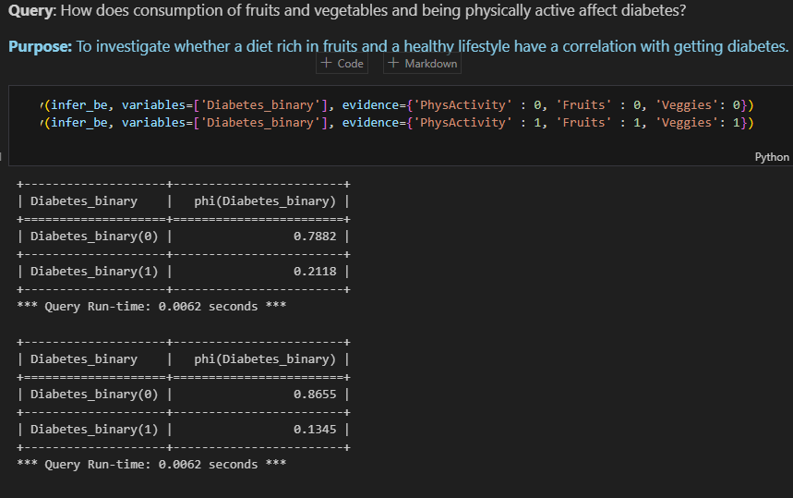
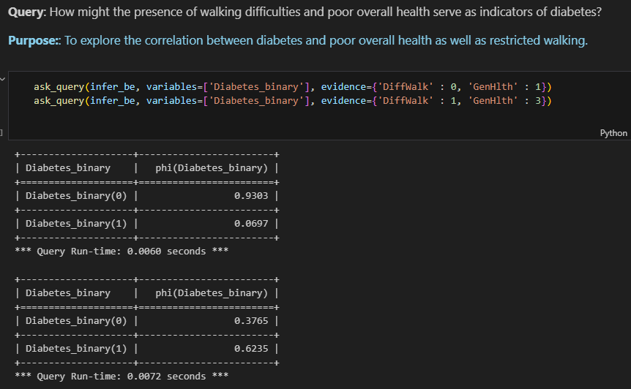

Slide 14
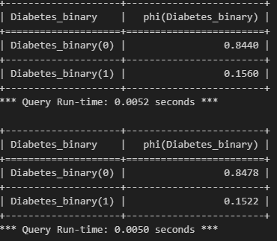
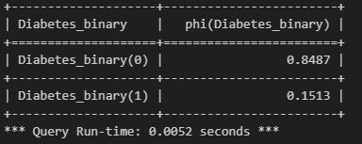
Whether people smoke or not has little to do with their chance of developing diabetes.
It was expected since the edge between smoking and diabetes was categorized as a low-confidence edge determined by domain- experts.
I expected that the chance of developing diabetes would increase since I read about the dangers of heavy alcohol consumption, but I didn’t observe it here. It can be for two reasons:
1. The prevalence of heavy drinkers in the dataset might be too low to establish a strong statistical association with diabetes.
2. The paper does not specify if it's focusing on Type 1 or Type 2 diabetes, and the impact of alcohol consumption might vary significantly between these types.

Slide 15
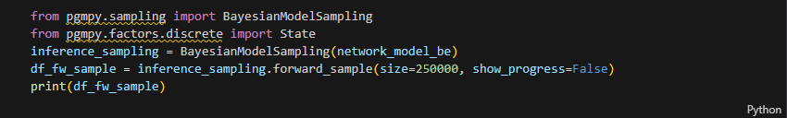
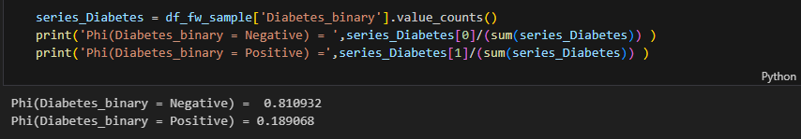
Forward sampling:

Slide 16
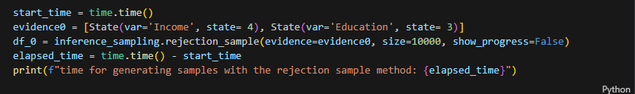
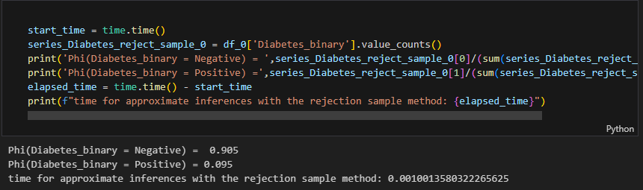
Rejection Sampling:
P(Diabetes_binary∣Income=4,Education=3)

Slide 17
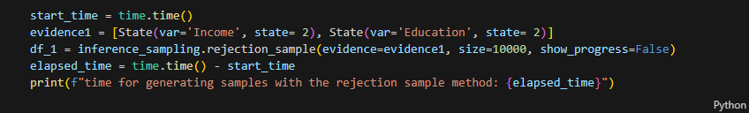
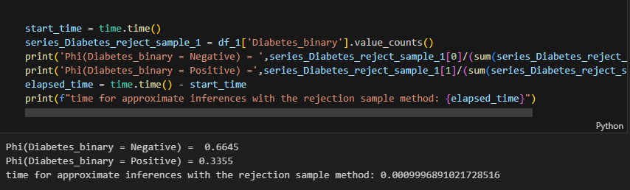
P(Diabetes_binary∣Income=2,Education=2)

Slide 18
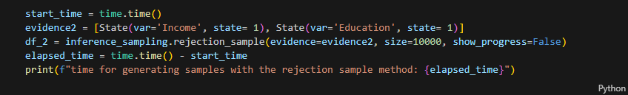
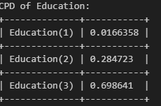
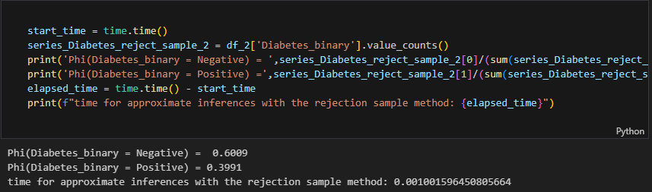
P(Diabetes_binary∣Income=1,Education=1)

Slide 19
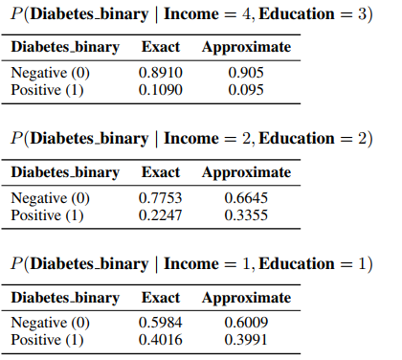
Comparison between Exact and Approximate inference:
it takes longer to generate samples for "Income = 1 and Education = 1" but still yields results close to exact inference illustrates the trade-offs between computational efficiency and accuracy in probabilistic modeling. It also underscores the importance of understanding the underlying data distribution and ensuring adequate sample sizes in approximate inference methods to achieve reliable results.
The case of "Income = 2, Education = 2" illustrates that even when sample generation is efficient, the accuracy of results can vary significantly. It highlights the need for careful consideration of both the method used and the nature of the data being modeled.
For more complex conditions, methods that can handle variability and complexity more adeptly (like MCMC) are suggested.

Slide 20



Thanks
Please keep this slide for attribution

Slide 21
Fonts & colors used
This presentation has been made using the following fonts:
Space Grotesk
(https://fonts.google.com/specimen/Space+Grotesk)
Cairo
(https://fonts.google.com/specimen/Cairo)
#1a2340
#ffffff
#0009a6
#b338f4
#de465d
#ff6f00
#72ebc3
#fec8c9

